Slide 1
Complexity Analysis

Slide 2
Pseudocodes
● High level description
● Intended for humans
● More structured than prose
● Hides implementation / design details
● Less structured than programs
Expression
‘← ‘ for assignment and ‘=‘ for equality
Mathematical expressions are allowed
Method declaration
Algorithm name (param1, param2,...)
Decision structure
While/ for/ repeat loops
Array indexing
Method calls
Method returns
Defines new method ‘name’ with arguments
If condition then Action1 else Action 2
Use indentations
While condition do Action-1
Repeat Action-1 until condition
A[i] indexes to the ith element of array A
Object.method(param1, param2,...)
Object is optional
Return value

Slide 3
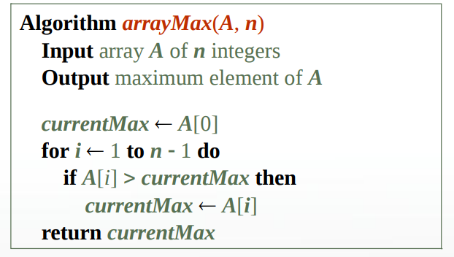
Pseudocodes
Example: Pseudocode for finding the maximum element in an Array

Slide 4
Analyzing Algorithms
Algorithms can be analyzed based on the following parameters:
● Correctness
●Amount of Work done
● Space used
● Simplicity, clarity
● Optimality

Slide 5
Correctness
Understand what correctness means
Define the characteristics of the input an algorithm is expected to work on
The results that each input must produce
Prove the statement about the relationship between input and output
Prove Correctness of algorithm

Slide 6
Correctness
Specify the task to be performed by the algorithm
Specification consists of:
Name of algorithm and list of its arguments
Initial condition (it specifies what is correct input data to the problem)
Final condition (it specifies what is the desired result of the algorithm)
An algorithm is called totally correct for the given specification if and only if for any correct input data it:
stops
returns correct output

Slide 7
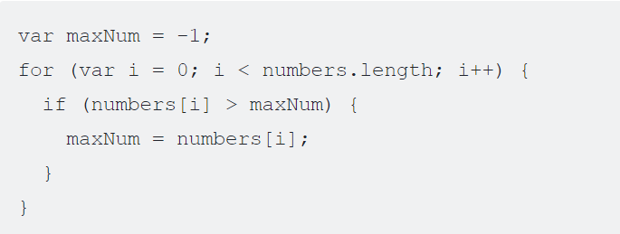
Example revisited
Yes
Numbers= {13, 4 12, 27}
Is it working??????
Will it stop????
Numbers= {-13, -4, -12, -27}
Is it working??????
No
Is the Result correct??

Slide 8
Example revisited
Change this to maxNum=numbers[0]
Yes
Numbers= {13, 4 12, 27}
Is it working??????
Will it stop????
Numbers= {-13, -4, -12, -27}
Is it working??????
Yes
Is the Result correct??

Slide 9
Correctness
Proof of Correctness
By example
By contrapositives and contradiction
Induction
Loop Invariants

Slide 10
Analyzing Algorithms
Analysis can be done for :
Resources required.
Memory / space required
Runtime requirements
An efficient algorithm requires less time, space, resources and computations
Analyzing runtime requirements are of utmost importance
Obvious way to measure the efficiency of an algorithm is to run it and measure how much processor time is needed
Is it correct ??????
NO... But WHY??????

Slide 11
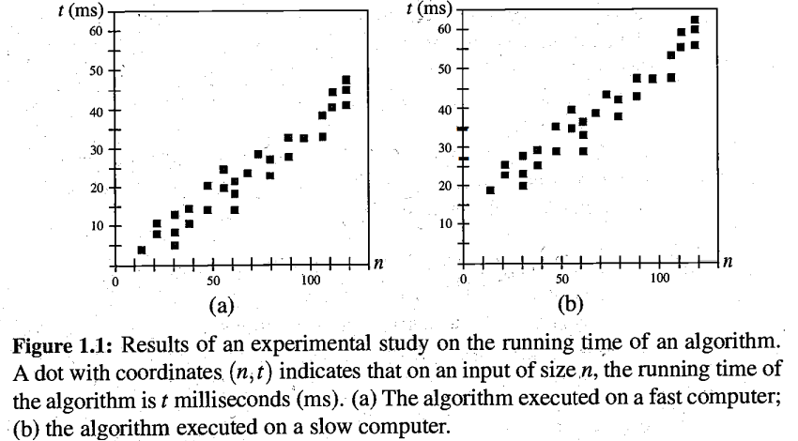
Analyzing Algorithms
Factors:
Hardware
Operating System
Compiler
Size of input
Nature of Input
Solution
Theoretical approximation is preferred
- It characterizes the execution time of an algorithm independently from the machine, the language and compiler.
- Analyzing variation in runtime requirements with changing size of input data
- Comparisons of different algorithms.

Slide 12
Analyzing Algorithms
Runtime complexity of algorithm
Varies with input size
Nature of input data
Model of Computation:
Mathematical model
Asymptotic Notations

Slide 13
Analyzing Algorithms: Runtime Complexity
It is of three types:
(a) Best-case:
- Describes an algorithm's behavior under optimal conditions.
- Searching an element present at first position
(b) Average-case:
- Provides the cost of algorithm for average case of data.
- Analyzing average data and cost is difficult.
(c) Worst-case:
- Provides upper-bound or maximum cost of algorithm.
- Safe analysis of over-all behaviour.
Mostly worst-case analysis of the algorithms is computed for comparisons.

Slide 14
Analyzing Runtime Complexity
Random Access Machine Model:
Counts the primitive operations / computations
Assumes that CPU performs single primitive operation in 1 unit time
Primitive operations are identified and counted to analyze cost
–Assigning a value to a variable
–Performing an arithmetic operation
–Calling a method
–Comparing two numbers
–Indexing into an array
–Following an object reference
–Returning from a method

Slide 15
Analyzing Time Complexity
Counting primitive operations:
Algorithm FindMax(S, n)
Input : An array S storing n numbers,n>=1
Output: Max Element in S
S1: curMax ← A[0]
S2: i ← 1
S3: while i <= (n-1) do
S4: if curMax < A[i] then
S5: curMax ← A[i]
S6: i ← i+1;
S7: return curmax
Complexity between 6n and 8n-2

Slide 16
Analyzing Time Complexity
Counting primitive operations:
Algorithm FindMax(S, n)
Input : An array S storing n numbers,n>=1
Output: Max Element in S
S1: curMax ← A[0] 2 op (ind & assign)
S2: i ← 1 1 op (assign)
S3: while i<= n-1 do 2n op (n comp+n sub)
S4: if curMax < A[i] then 2(n-1) op (n-1 [] & n-1 <)
S5: curMax ← A[i] 0 to 2(n-1) op
S6: i ← i+1; 2(n-1) op (+ & ->)
S7: return curmax 1 op
Complexity between 6n and 8n-2

Slide 17
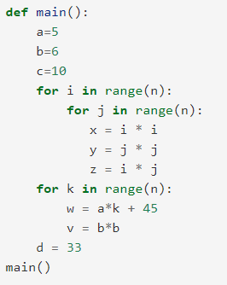
Practice problems

Slide 18
Practice problems
3+3n^2 + 2n+1
=3n^2 + 2n + 4
OR
3+6n^2+5n+1

Slide 19
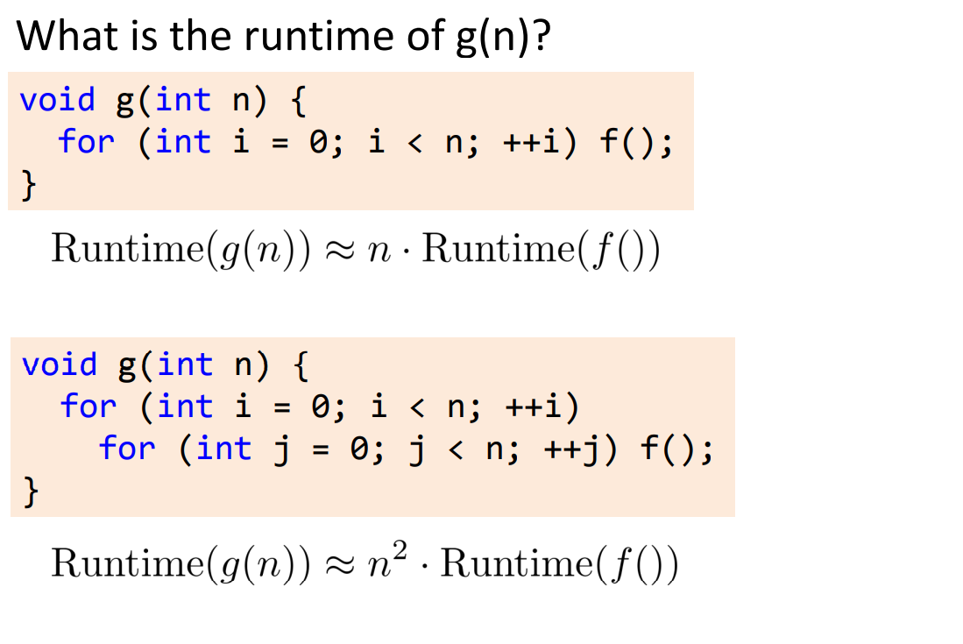
Practice problems

Slide 20
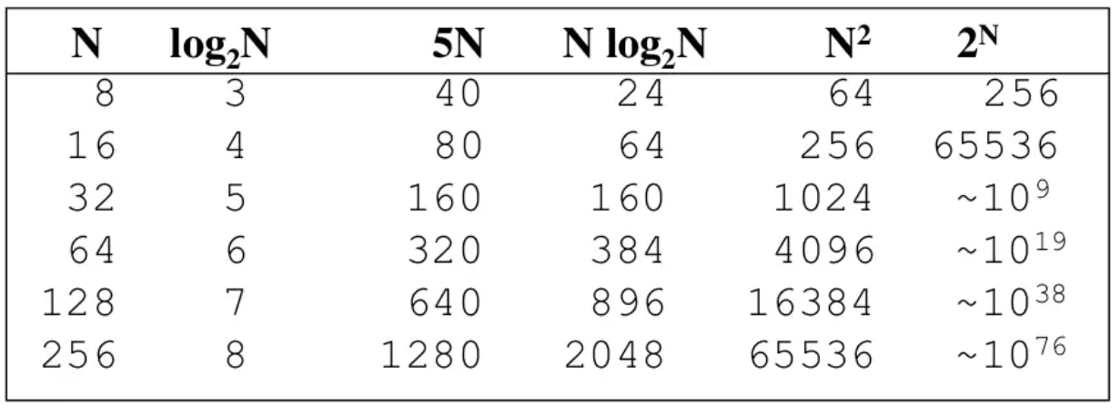
Problem Solving and Analysis
Difference in complexity matters!!!!!

Slide 21
Practice problems
Constant factor can be dropped
n
f(n) will be called n times
Constant factor can be dropped
n²
‘j’ for loop will be computed n times
One ‘j’ loop will call f() n times

Slide 22
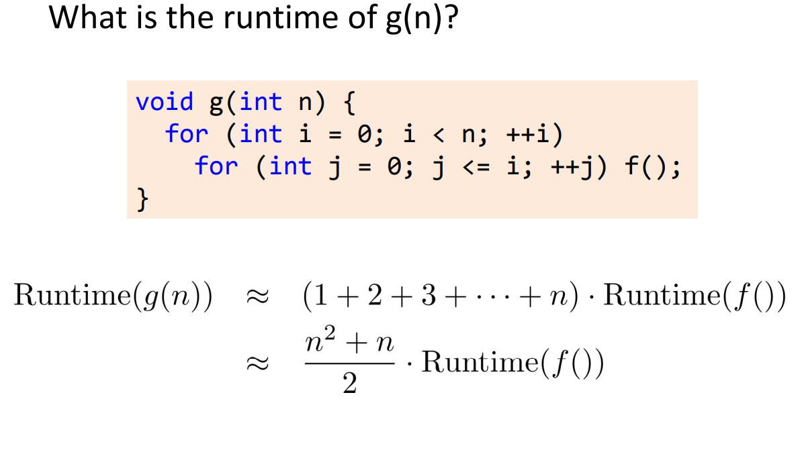
Practice problems
Constant factor can be dropped
O(n)
Constant factor can be dropped
O(n²)

Slide 23
Practice problems
Constant factor can be dropped
O(n)
Constant factor can be dropped
O(n²)

Slide 24
Practice problems
int a = 0, b = 0;
for (i = 0; i < N; i++)
{
a = a + rand();
}
for (j = 0; j < M; j++)
{
b = b + rand();
}
Time complexity= N+M
Space Complexity= O(1)

Slide 25
Practice problems
function isPrime(n) {
for (for i = 2; i <= sqrt(n); ++i) {
if (n % i === 0) { return false; } } return true; }
Time complexity= SQRT(n)

Slide 26
Practice problems
int a = 0, i = N;
while (i > 0) {
a += i;
i /= 2;
}
N=32
I=32, 16, 8, 4 2 1
Time complexity= Log N base 2

Slide 27
Practice problems
for(var i=0;i<n;i++)
{ i*=k
}
K=2
N=40
i=
Time complexity= Log n base k

Slide 28
Practice problems
let a = 0, b = 0; for (let i = 0; i < n; ++i)
{ for (let j = 0; j < n; ++j) { a = a + j; } } for (let k = 0; k < n; ++k)
{ b = b + k; }
Time complexity= n^2+n

Slide 29
Practice problems
int i, j, k = 0;
for (i = n / 2; i <= n; i++)
{
for (j = 2; j <= n; j = j * 2)
{
k = k + n / 2;
}
}
Time complexity=?

Slide 30
Practice problems
int i, j, k = 0;
for (i = n / 2; i <= n; i++)
{
for (j = 2; j <= n; j = j * 2)
{
k = k + n / 2;
}
}
Time complexity=nlogn
If you notice, j keeps doubling till it is less than or equal to n.
Number of times, we can double a number till it is less than n would be log(n).
Let’s take the examples here. for n = 16, j = 2, 4, 8, 16 for n = 32, j = 2, 4, 8, 16, 32
So, j would run for O(log n) steps. i runs for n/2 steps. So, total steps = O(n/ 2 * log (n)) = O(n*logn)

Slide 31
Practice problems
int count = 0;
for (int i = N; i > 0; i /= 2)
{
for (int j = 0; j < i; j++)
{
count += 1;
}
}
Time complexity=???

Slide 32
Practice problems
int count = 0;
for (int i = N; i > 0; i /= 2)
{
for (int j = 0; j < i; j++)
{
count += 1;
}
}
Time complexity=n
In the first iteration, the j loop runs N times.
In the second iteration, the j loop runs N/2 times.
In the third iteration, the j loop runs N/4 times.
.
.
.
In the ith iteration, the j loop runs N/2^i times.
So, the total number of runs of loop =
N + N / 2 + N / 4 + N/8 + …
Last term will be 1
= N * ( 1 + 1/2 + 1/4 + 1/8 + … ) < 2 * N

Slide 33
Practice problems : homework
void counter(int n)
{
for(int i = 0 ; i < n ; i++)
{
for(int j = 1 ; j<n ; j += i )
{
cout<<i<<” ”<<j;
}
cout<<endl;
}
}
Time complexity=

Slide 34
Practice problems
void counter(int n)
{
for(int i = 0 ; i < n ; i++)
{
for(int j = 1 ; j<n ; j += i )
{
cout<<i<<” ”<<j;
}
cout<<endl;
}
}
Time complexity=nLogn
For i=1; j runs n/1 times
For i=2; j runs n/2 times
For i=3; j runs n/3 times
.
.
.
For i=n; j runs n/n times
Adding it up
(n/1 + n/2 + n/3 + …. + n/n) =
n (1/1 + 1/2 +1/3 + …. 1/n)=n * Log n

Slide 35
Analyzing Time Complexity
Important factor to be considered when estimating complexity
When experimental setup (hardware/software) changes
Running time/memory is affected by a constant factor
2n or 3n or 100n is still linear
Growth rate of the running time/memory is not affected
Growth rates of functions
Linear
Quadratic
Exponential

Slide 36
Asymptotic Complexity Analysis: Big O
A method to characterize the execution time of an algorithm
Provides the upper bound or worst-case complexity analysis
Adding two square matrices is O(n2 )
Searching in a array is O(n) (linear search)
Searching in a array is O(Log n) (binary search)
Multiplying two square matrices is O(n3 )
The O notation only uses the dominating terms of the execution time. Constants are disregarded.

Slide 37
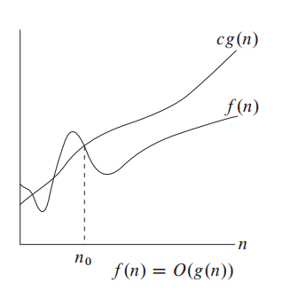
Asymptotic Complexity Analysis: Big O
Let f(n) be the running time for an algorithm
Mostly analysis is done
for larger ‘n’

Slide 38
Asymptotic Complexity Analysis: Big O
Example
Show 7n-2 is O(n)
Here f(n)= 7n-2
g(n)=n
–need c > 0 and n₀ >= 1 such that
7n-2 <= cn for n >= n₀
–this is true for c = 7 and n₀ <= 1
T(n) => O(f(n)) if
T(n) <= c.f(n) when n> n₀
Multiple values of C and n₀ are possible

Slide 39
Asymptotic Complexity Analysis: Big O
Algorithm FindMax(S, n)
Input : An array S storing n numbers,n>=1
Output: Max Element in S
S1: curMax ← A[0] 2 op (ind & assign)
S2: i ← 1 1 op (assign)
S3: while i<= n-1 do 2n op (n comp+n sub)
S4: if curMax < A[i] then 2(n-1) op (n-1 [] & n-1 <)
S5: curMax ← A[i] 0 to 2(n-1) op
S6: i ← i+1; 2(n-1) op (+ & ->)
S7: return curmax 1 op
Complexity between 6n and 8n-2
Prove T(n) = 8n-2 is O(n)
show T(n) = 8n-2 is O(n)
Sol:
8n-2 <= c.n
= -2 <= n (c-8)
= n>= 2/(8-c)
= c=6 and n₀>=1

Slide 40
Asymptotic Complexity Analysis: Big O
Example
Show 3n³ + 20n² + 5 is O(n³)
Sol
–need c > 0 and n₀ >= 1 such that
3n³ + 20n² + 5 <= cn³ for n >= n₀
–this is true for c = 4 and n₀ = 21
T(n) => O(f(n)) if
T(n) <= c.f(n) when n> n₀
Another way to prove
3n³ < (3n³ + 20n² + 5) <= (3+20+5) n³
3n³ < (3n³ + 20n² + 5) <= (28) n³
C=28 ; Constant term.
Hence proved

Slide 41
Asymptotic Complexity Analysis: Big O
Example
n² is not O(n)
- Must prove n² <= cn
–n <= c
–The above inequality cannot be satisfied since c must be a constant
–Hence proof by contradiction
Example
Show 3 log n + log log n is O(log n)
need c > 0 and n₀ >= 1 such that
3 log n + log log n <= c log n for n >= n₀ 
this is true for c = 4 and n₀ = 2
OR
3 log n + log log n <= (3+1) Log n
3 log n + log log n <= 4 Log n
Hence O(log n) as ‘4’ is a constant

Slide 42
Asymptotic Complexity Analysis: Big O
The big-Oh notation gives an upper bound on the growth rate of a function
The statement “f(n) is O(g(n))” means that the growth rate of f(n) is no more than the growth rate of g(n)
We are guaranteeing that f(n) grows at a rate no faster than g(n)
Both can grow at the same rate
Though 1000n is larger than n² , n² grows at a faster rate
n² will be larger function after n = 1000
Hence 1000n = O(n)
The big-Oh notation can be used to rank functions according to their growth rate

Slide 43
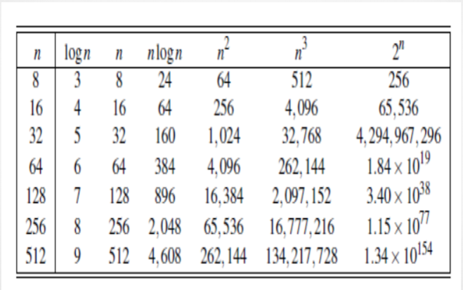
Asymptotic Complexity Analysis: Big O
Growth rate analysis of different functions

Slide 44
Asymptotic Complexity Analysis: Big O
4. What does it mean when we say that an algorithm X is asymptotically more efficient than Y? Options:
a. X will always be a better choice for small inputs
b. X will always be a better choice for large inputs
c. Y will always be a better choice for small inputs
d. X will always be a better choice for all inputs
Answer=

Slide 45
Asymptotic Complexity Analysis: Big Oh
If is f(n) a polynomial of degree d, then f(n) is O(n^{d}), i.e.,
Drop lower-order terms
Drop constant factors
Use the smallest possible class of functions to represent in big Oh
“2n is O(n)”
Use the simplest expression of the class
“3n+ 5 is O(n)” instead of “3n + 5 is O(3n)”

Slide 46
Asymptotic Complexity Analysis: Big Oh
Constant factor can be dropped
O(n)
f(n) will be called n times
Constant factor can be dropped
O(n²)
‘j’ for loop will be computed n times
One ‘j’ loop will call f() n times

Slide 47
Asymptotic Complexity Analysis: Big Oh
Constant factor can be dropped
O(n)
Constant factor can be dropped
O(n²)

Slide 48
Asymptotic Complexity Analysis: Big Oh
Constant factor can be dropped
O(n)
Constant factor can be dropped
O(n²)

Slide 49
Asymptotic Complexity Analysis: Big Oh
int a = 0, b = 0;
for (i = 0; i < N; i++)
{
a = a + rand();
}
for (j = 0; j < M; j++)
{
b = b + rand();
}
Time complexity=
Space Complexity=

Slide 50
Asymptotic Complexity Analysis: Big Oh
function isPrime(n) {
for (for i = 2; i <= sqrt(n); ++i) { if (n % i === 0) { return false; } } return true; }
Time complexity=

Slide 51
Asymptotic Complexity Analysis: Big Oh
int a = 0, i = N;
while (i > 0) {
a += i;
i /= 2;
}
N=16
I=16,8,4,2,1
Time complexity=

Slide 52
Asymptotic Complexity Analysis: Big Oh
for(var i=0;i<n;i++)
{ i*=k
}
K=2
N=40
i=
Time complexity=

Slide 53
Asymptotic Complexity Analysis: Big Oh
let a = 0, b = 0; for (let i = 0; i < n; ++i)
{ for (let j = 0; j < n; ++j) { a = a + j; } } for (let k = 0; k < n; ++k)
{ b = b + k; }
Time complexity=

Slide 54
Asymptotic Complexity Analysis: Big Oh
int i, j, k = 0;
for (i = n / 2; i <= n; i++)
{
for (j = 2; j <= n; j = j * 2)
{
k = k + n / 2;
}
}
Time complexity=?

Slide 55
Asymptotic Complexity Analysis: Big Oh
int i, j, k = 0;
for (i = n / 2; i <= n; i++)
{
for (j = 2; j <= n; j = j * 2)
{
k = k + n / 2;
}
}
Time complexity=nlogn
If you notice, j keeps doubling till it is less than or equal to n.
Number of times, we can double a number till it is less than n would be log(n).
Let’s take the examples here. for n = 16, j = 2, 4, 8, 16 for n = 32, j = 2, 4, 8, 16, 32
So, j would run for O(log n) steps. i runs for n/2 steps. So, total steps = O(n/ 2 * log (n)) = O(n*logn)

Slide 56
Asymptotic Complexity Analysis: Big Oh
int count = 0;
for (int i = N; i > 0; i /= 2)
{
for (int j = 0; j < i; j++)
{
count += 1;
}
}
Time complexity=???

Slide 57
Asymptotic Complexity Analysis: Big Oh
int count = 0;
for (int i = N; i > 0; i /= 2)
{
for (int j = 0; j < i; j++)
{
count += 1;
}
}
Time complexity=O(n)
In the first iteration, the j loop runs N times.
In the second iteration, the j loop runs N/2 times.
In the third iteration, the j loop runs N/4 times.
.
.
.
In the ith iteration, the j loop runs N/2^i times.
So, the total number of runs of loop =
N + N / 2 + N / 4 + N/8 + …
Last term will be 1
= N * ( 1 + 1/2 + 1/4 + 1/8 + … ) < 2 * N

Slide 58
Problem solving
void counter(int n)
{
for(int i = 0 ; i < n ; i++)
{
for(int j = 1 ; j<n ; j += i )
{
cout<<i<<” ”<<j;
}
cout<<endl;
}
}
Time complexity=????????

Slide 59
Asymptotic Complexity Analysis: Big Oh
Algorithm A and B have a worst-case running time complexity, respectively. Therefore, algorithm B always runs faster than the algorithm A.
TRUE / FALSE

Slide 60
Problem solving
● Show that 8n+5 is O(n)
●Show that 20n³ +10n²+5 is O(n³)
●Show that 3logn+2 is O(logn).
Arrange the following functions in order of their complexities.
5n², log₃n, 20n, log₂n, n^{2/3}, 2n, 2¹⁰⁰,n¹⁰⁰⁰
Plot graph for the fucntions and verify your results.

Slide 61
N^2 and 2^N
Contradiction
Say 2^N = n^2
Apply log
N log 2 <= 2 log n
Log 2 and 2 are constants
N <= 2logn/ log2
Drop constants and then eq doesnt hold
What we assumed was wrong

Slide 62
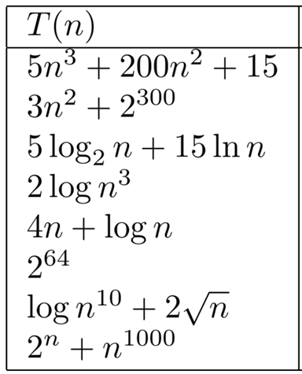
Practice problems
Prove the following

Slide 63
Problem solving
Order the following functions by the big-Oh notation 6nlogn, 2¹⁰⁰, log2n, 1/n, n³, n²logn
Plot graph and verify answers

